Slide 1
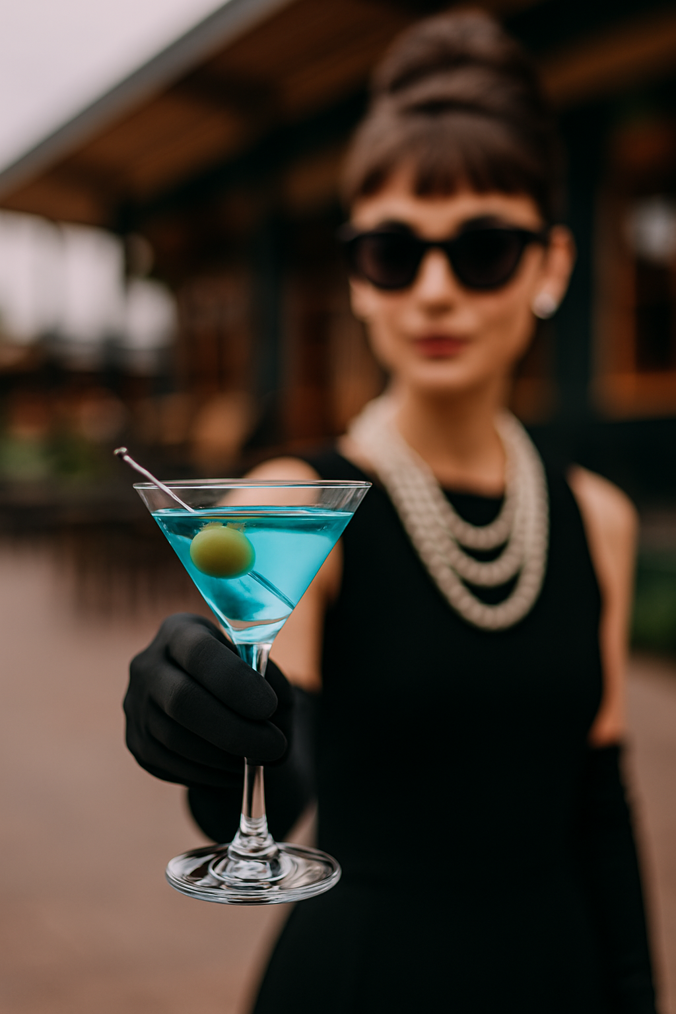
Darling, You simply must tell the bartender,
I’ll have a ‘TINI BIT OLDER
It’s the secret password at this little establishment

